Slide 1

Geometry
Unit 2, Lesson 4 Hypothesis and Conclusion Volume 1, pg. 97

Slide 2


Benchmark
MA.912.LT.4.3
Identify and accurately interpret “if…then,” “if and only if,” “all” and “not” statements. Find the converse, inverse, and contrapositive of a statement.
volume 1, pg. 97

Slide 3
Integrated Mathematical Thinking and Reasoning Standards
MA.K12.MTR.1.1 Actively participate in effortful learning both individually and collectively.
MA.K12.MTR.4.1 Engage in discussions that reflect on the mathematical thinking of self and others.
MA.K12.MTR.5.1 Use patterns and structure to help understand and connect mathematical concepts.
MA.K12.MTR.7.1 Apply mathematics to real-world contexts.
volume 1, pg. 97

Slide 4

Learning Targets
I can identify the hypothesis of a statement.
I can identify the conclusion of a statement.
I can write the converse, inverse, and contrapositive of a conditional statement.
volume 1, pg. 97

Slide 5

Warm-Up
volume 1, pg. 98

Slide 6

2.4.1 Warm-Up: Protype Fabricator
Jeff Tiedeken is a prototype fabricator. He creates metal prototypes through bending, cutting, welding, and assembling.
Jeff states that most people who come in for help do not have an idea of what they need, so his first job is to understand the problem.
How does understanding the problem help?
Jeff said that once he understands the problem, he then solves the problem with other people.
Why do you think discussing a problem with others can be helpful?
volume 1, pg. 98

Slide 7

Guided Instruction
volume 1, pg. 98

Slide 8
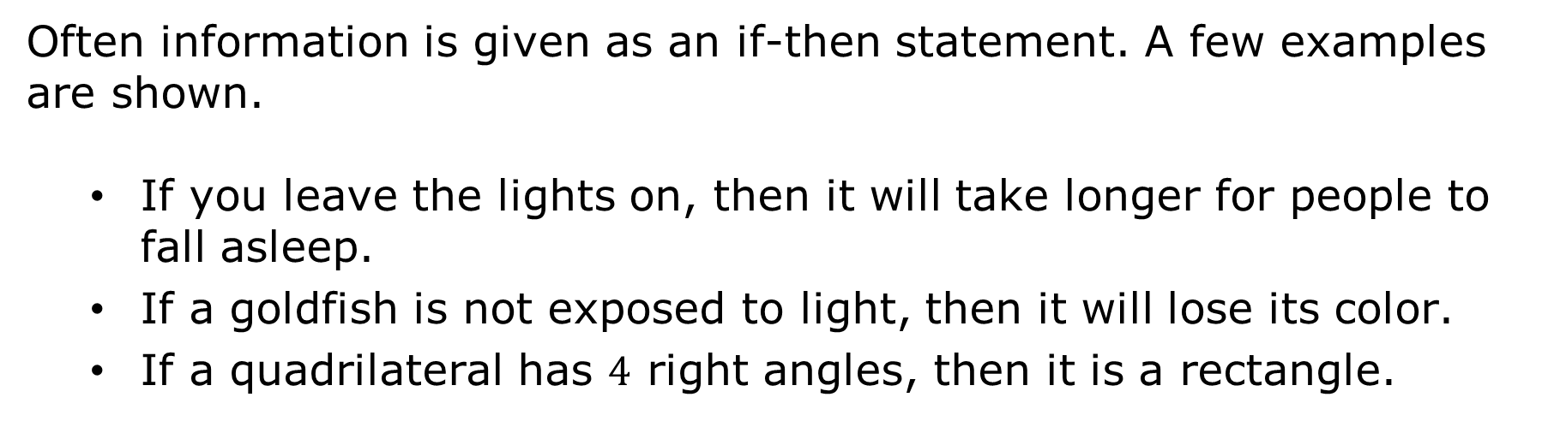
2.4.2 Guided Instruction: Hypothesis and Conclusion
Often information is given as an if-then statement. A few examples are shown.
If you leave the lights on, then it will take longer for people to fall asleep.
If a goldfish is not exposed to light, then it will lose its color.
If a quadrilateral has $4$ right angles, then it is a rectangle.
volume 1, pg. 98

Slide 9
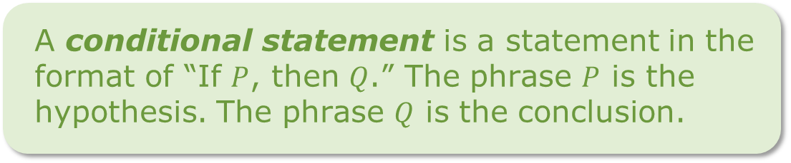
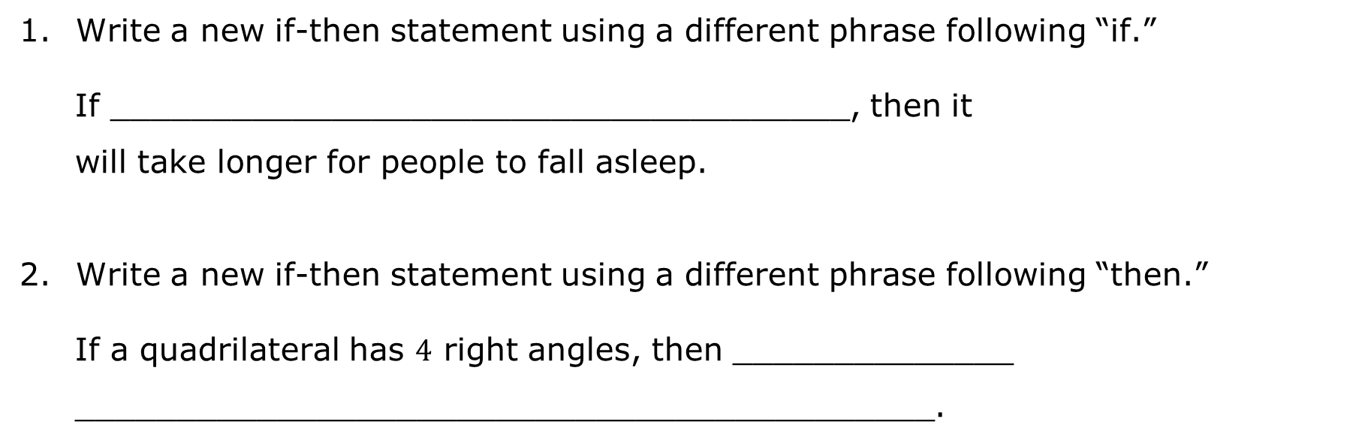
Write a new if-then statement using a different phrase following “if.”
If _____________________________________, then it
will take longer for people to fall asleep.
Write a new if-then statement using a different phrase following “then.”
If a quadrilateral has $4$ right angles, then ______________
___________________________________________.
A conditional statement is a statement in the format of “If $P$, then $Q$.” The phrase $P$ is the hypothesis. The phrase $Q$ is the conclusion.
volume 1, pg. 98

Slide 10
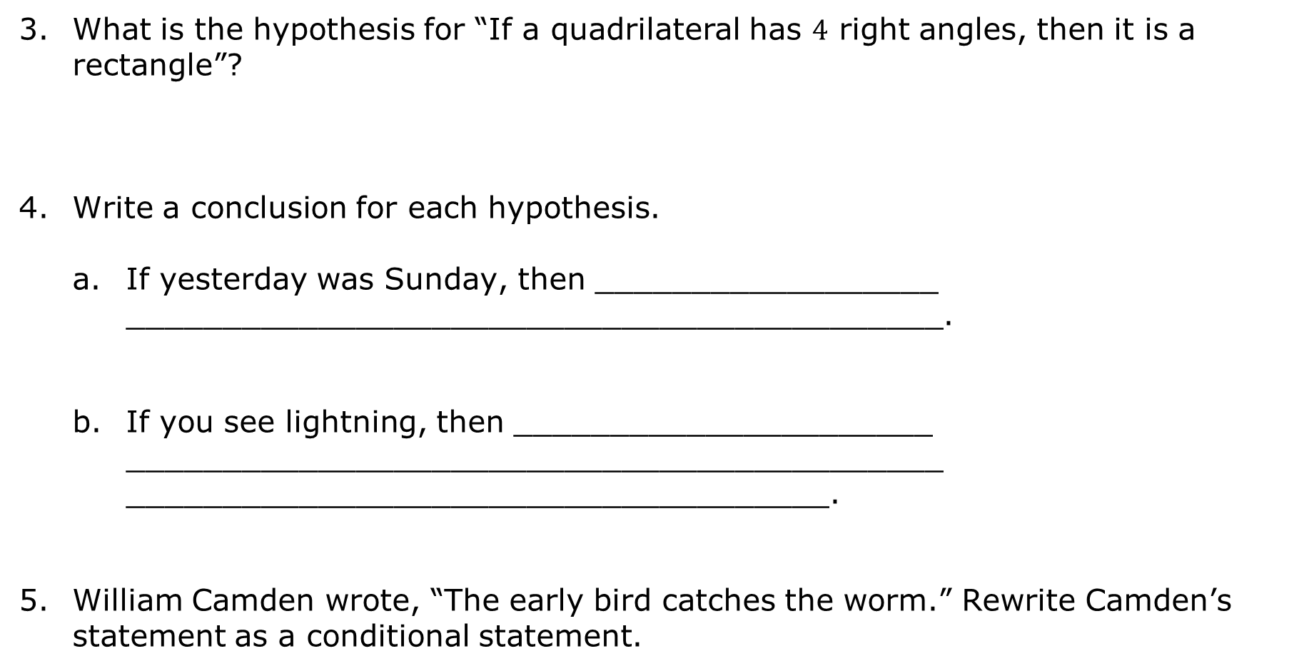
What is the hypothesis for “If a quadrilateral has $4$ right angles, then it is a rectangle”?
Write a conclusion for each hypothesis.
If yesterday was Sunday, then __________________ ___________________________________________.
If you see lightning, then ______________________ ___________________________________________ _____________________________________.
William Camden wrote, “The early bird catches the worm.” Rewrite Camden’s statement as a conditional statement.
volume 1, pg. 99

Slide 11

Exploration
volume 1, pg. 99

Slide 12

2.4.3 Exploration: Switching the Hypothesis and Conclusion
Draw a square or a triangle.
If you drew a square, then draw a circle inside the square.
If you drew a triangle, then draw a circle outside the triangle.
volume 1, pg. 99

Slide 13
Discuss with your partner what happens when the hypothesis and conclusion of each conditional are switched.
If you drew a circle inside the square, then draw a square.
If you drew a circle outside the triangle, then draw a triangle.
Summarize your discussion.
volume 1, pg. 99

Slide 14
Guided Instruction
volume 1, pg. 100

Slide 15
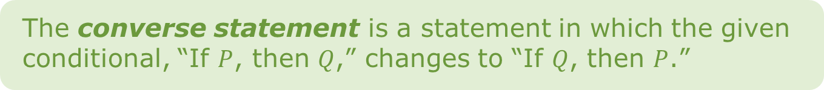
2.4.4 Guided Instruction: Converse, Inverse, and Contrapositive
The converse statement is a statement in which the given conditional, “If $P$, then $Q$,” changes to “If $Q$, then $P$.”
Write the converse of “If it is raining, then the grass is wet.”
Write a counterexample that shows the converse is not true.
volume 1, pg. 100

Slide 16
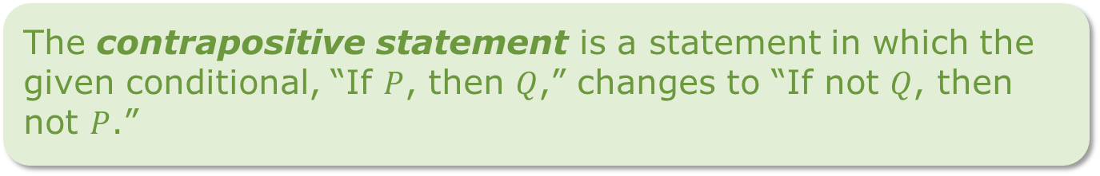
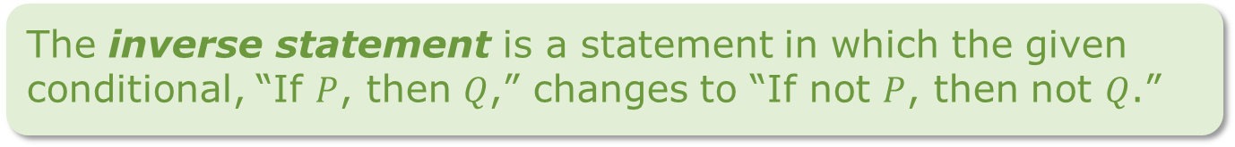
The inverse statement is a statement in which the given conditional, “If $P$, then $Q$,” changes to “If not $P$, then not $Q$.”
Complete the inverse for “If it is raining, then the grass is wet.”
If it is _______ raining, then the grass is _______ wet.
Write a counterexample that shows the inverse is not true.
Write the contrapositive for “If it is raining, then the grass is wet.”
The contrapositive statement is a statement in which the given conditional, “If $P$, then $Q$,” changes to “If not $Q$, then not $P$.”
volume 1, pg. 100

Slide 17

Guided Practice
volume 1, pg. 101

Slide 18

2.4.5 Guided Practice: Converse, Inverse, and Contrapositive
Write the converse, inverse, and contrapositive for each conditional.
“If you're not making mistakes, then you're not doing anything.” (Quote by John Wooden, an American basketball player and coach)
Converse
Inverse
Contrapositive
volume 1, pg. 101

Slide 19
“If you think you’re always in control, then you’re not going fast enough.” (Quote by Mario Andretti)
Converse
Inverse
Contrapositive
volume 1, pg. 101

Slide 20

Wrap-Up
volume 1, pg. 101

Slide 21
2.4.6 Wrap-Up: Cool Down
Rewrite the following quote by Michelle Obama as a conditional statement.
“When someone is cruel or acts like a bully, you don't stoop to their level.”
Complete the table for the conditional statement shown.
If you have ridden the roller coaster SheiKra, then you have been to Busch Gardens.
Hypothesis
Conclusion
volume 1, pg. 101

Slide 22
Write the converse, inverse, and contrapositive for the conditional statement shown.
If a fruit is yellow, then it is a banana.
Converse
Inverse
Contrapositive
volume 1, pg. 101

